Slide 1
Managing Anxiety
Notes:
Need stickers

Slide 2
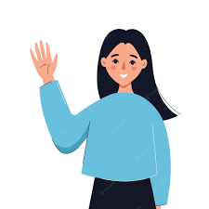
Who Are We?
My name is Beth
I am an Educational Mental Health Practitioner from the Mental Health Support Team.
I am here to talk to you about managing feelings of anxiety.

Slide 3
Aims of today
Think about what anxiety is
Learn how to identify when you are worried or stressed
Learn strategies to feel better

Slide 4
What is anxiety?
Uncomfortable but entirely natural
A problem when it interferes with everyday lives
Another word for worry
Notes:
What does everyone know about anxiety?
Anxiety is another word to describe ‘worry or stress’. People who worry a lot are said to be ‘anxious’. It describes the uncomfortable feelings you get when you worry. You might like to use another word for anxiety, like my ‘worry bug’ or some things else that feels right.

Slide 5
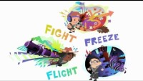
Why do we have anxiety?
Notes:
A simple answer to this is that something has knocked your confidence and caused you to feel worried. It may be a thought; e.g., ‘What if my mum forgets to pick me up from school?’ or an experience that makes the world seem scary, e.g. ‘What if I can’t stop my hic-ups!’

Slide 6
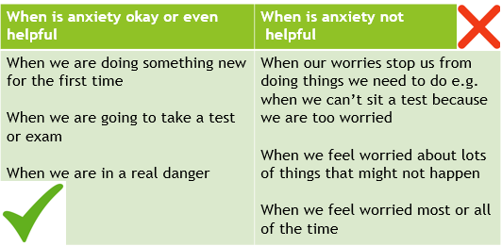
When is Anxiety Helpful and Unhelpful

Slide 7
I can’t sleep at night because I have too many worries
Notes:
Thumbs down

Slide 8
I am worried that every dog will bite me!
Notes:
Thumbs down

Slide 9
I am worried about going to high school.
Notes:
Thumbs up

Slide 10
I am worried I will get my math questions wrong, so I just won’t do them!
Notes:
Thumbs up

Slide 11
I’m am worried about doing my SATs
Notes:
Thumbs up

Slide 12
Where do we feel anxiety in our bodies?
How our body lets us know we are worried or anxious | What we feel or see in our bodies
Blood pumps faster to muscles | Heart races, flushed appearance, wobbly legs
Body warms up ready to get going | Sweaty palms, raised temperature
Energy diverts from non-essential tasks | Lack of concentration, butterflies in our tummies
Notes:
Does anyone know where we feel anxiety in our bodies?
Anxiety is not a bad thing; it is just your body’s way of letting you know you’re worried or scared by something. It may feel uncomfortable and it is often linked to feeling sick, shaky or sweaty, butterflies in your tummy, wobbly legs, racing heart or breathlessness. These feelings always pass. Remember you can’t die from anxiety.

Slide 13
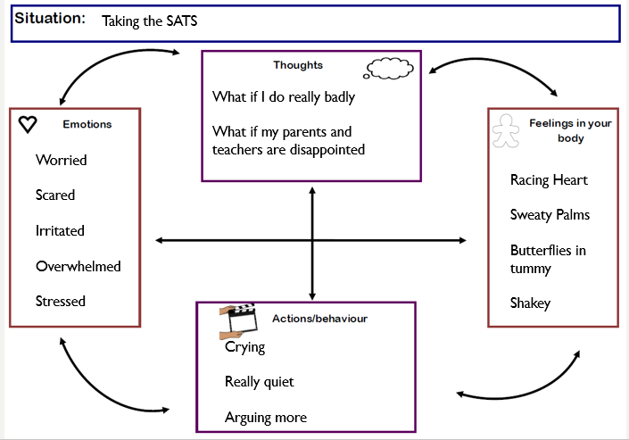

Slide 14
Managing anxious feelings
Learn to relax (muscle relaxation)
Finger breathing
Mindfulness
Physical exercise
Butterfly hug
Write down your feelings and talk about them

Slide 15
Managing negative thoughts
Distraction activity (colouring, watch a movie, listen to music, 54321)
Find the positive
Worry jar
Talk to someone
Remember negative thoughts are opinions not facts- find the facts!
Notes:
Anyone you can trust and can talk to can help you with your anxiety. They can help you problem solve and find ways to make your anxiety seem much smaller or help you to relax.

Slide 16
Action plan
What is worrying you? Write a list or talk it out with someone you trust
Think about what you can do to manage your worried feelings and negative thoughts
Recognise you are feeling worried by listening to your body and mind
Practice your worry management strategy and check in to see if it's worked for you. If not try something new

Slide 17
Thanks for Listening!

Slide 18
Helpful resources
My Mind: https://www.mymind.org.uk/resources/mood/mental-health-difficulties/children-and-young-people/
Young Minds: https://youngminds.org.uk/find-help/conditions/anxiety/
Child Line: https://www.childline.org.uk/info-advice/your-feelings/anxiety-stress-panic/

