Slide 1
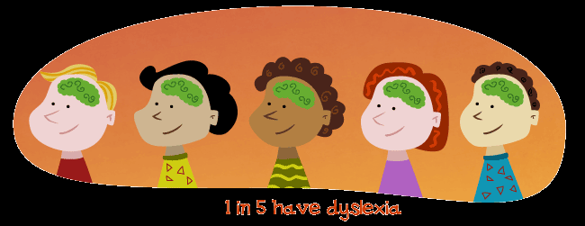
Dyslexia Parent Coffee Afternoon
With Dawn Brockett, Specialist teacher from Orrets Meadow

Slide 2
Agenda
1. What is Dyslexia and what does it mean?
2. Reading and Writing: How to help my child
3. Homework Tips
4. Key Top Tips
5. Websites and resources
6. Questions and Answers

Slide 3
1. What is Dyslexia? https://www.youtube.com/watch?v=zafiGBrFkRM
Definition: ‘dys’ means difficulty, ‘lexia’ means language
Dyslexia is a learning difference that primarily affects the skill involved in accurate and fluent word reading and spelling.
Characteristic features of dyslexia are difficulties in phonological awareness, verbal memory and verbal processing speed
Dyslexia occurs across a range of intellectual abilities
It is best thought of as a continuum, not a distinct category, and there are no clear cut off points
Co-occurring difficulties may be seen in aspects of language, motor coordination , mental calculation, concentration and personal organisation, but these themselves are not markers of dyslexia
A good indication of the severity and persistence of dyslexic difficulties can be gained by examining how the individual has responded to well-founded intervention.
SEE DYSLEXIA CHECKLIST

Slide 4
Famous People with Dyslexia

Slide 5
2. Reading and Writing: How to help my child.
How we teach Reading in school
Children learn to read through exposure to books, enjoyment and phonics instruction.
Phonics is the structured, systematic teaching of sounds that we use to read and write words.
This takes place in school every day for 20 minutes in KS1 and for children in KS2 who still require Phonics. It includes a taught session, practise and includes songs, rhymes.

Slide 6
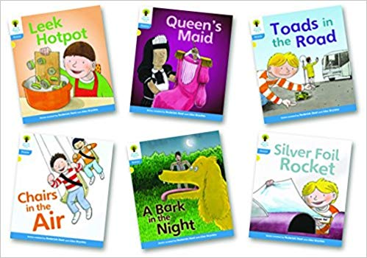
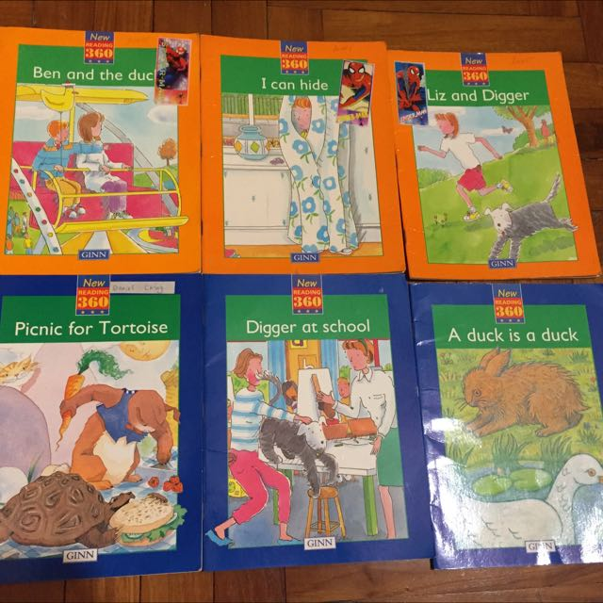
There are six phases where children learn the skills needed for reading AND knowledge of the alphabet.
Children are expected to have a secure knowledge of phonics and the alphabet by the time they move in to Year 3. In years 2 to 6, children learn about comprehension and strategies for spelling/ grammar.
Not every child will have reached this stage by Year 3. Some children might be more fluent reading ‘Look and Say’ books.

Slide 7
Glossary of Terms
- Phonemes: the smallest units of sound that are found within a word
- Grapheme: the spelling of the sound
- Digraph: two letters that make one sound when read
- Trigraph: three letters that make one sound
- CVC: stands for consonant, vowel, consonant
-Segmenting: breaking up a word into its sounds
- Blending : putting the sounds together to read a word
- Tricky words: words that cannot easily be decoded

Slide 8
Reading
What can I do to help my child read?
Share and enjoy books together- it is important to read to each other and discuss the books. Use of audio books.
Sharing and learning songs/ rhymes.
Appropriate books (Barrington Stokes) https://www.barringtonstoke.co.uk/
Games eg:
Beat the Bomb- read words in a list with your child against a timer. They have to read the words before the timer goes off.
‘Hidden in the Treasure box’ segment and child blends to find item.
Robot Talk
Finding rhyming words e.g. leg/peg or pig/leg- which rhyme?
Many board games can be adapted to include reading- pairs games, Snakes and Ladders but landing on words to go up the ladder etc.

Slide 9
Writing and Spelling

Slide 11
https://www.teachhandwriting.co.uk/index.html

Slide 12
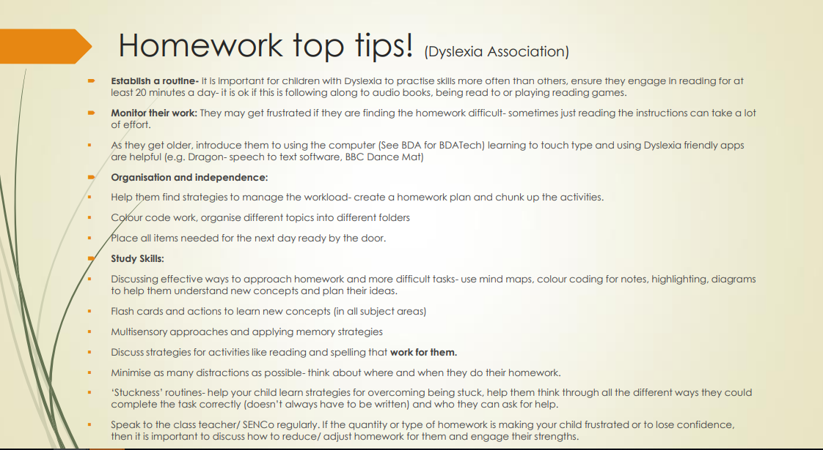

Slide 13
Key Message
With the right support, encouragement and praise, your child can and will achieve in education. Skills, knowledge and abilities are not fixed- our brains have the capacity to learn and change all the time.
TOP TIPS:
Be patient. Wait for a response after a question, they need time to process and think- count to 5 before prompting them.
If they are becoming frustrated- stop. Think of ways to reduce difficulties, talk to teachers and reassure your child.
Give praise for effort and learning often. “I like the way you tried to you use sounds to help you!”, “Well done, I can see you have made a diagram to help you.”
Break down what you say into more simple language.
Give them cues: “Three things to remember…” and be prepared to repeat yourself (Try to think of things from their perspective before you react)

Slide 14
Useful Websites and Resources.
BBC-https://www.bbc.co.uk/programmes/b006sf18/clips
Phonics Play- https://www.phonicsplay.co.uk/
Ictgames- https://www.ictgames.com/mobilePage/literacy.html
Family Learning- http://www.familylearning.org.uk/phonics_games.html
Wordsearch maker- http://puzzlemaker.discoveryeducation.com/WordSearchSetupForm.asp
Apps to download- https://keystagefun.co.uk/
Twinkl- https://www.twinkl.co.uk/resources/specialeducationalneeds-sen-cognition-and-learning/sen-specific-learning-difficulties/sen-dyslexia-support

